Slide 1



UNIT 6:
Around the world
Around Croatia

Slide 2
Are these names familiar to you:
Can you guess where they are?
What are they?
Which one might be a mountain / river / desert / country?
Atacama
Elbrus
Volga
Canada

Slide 3
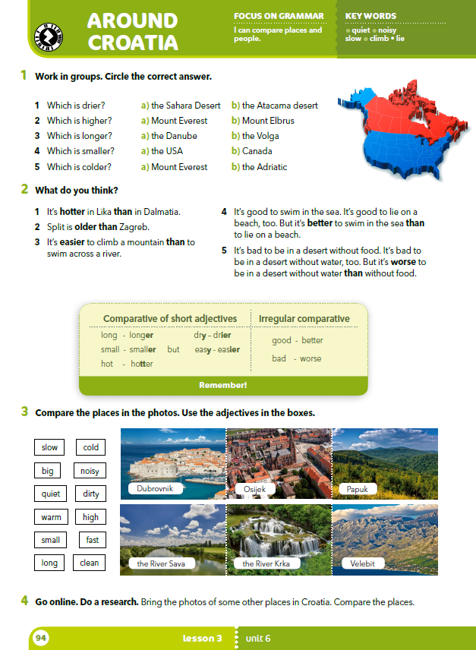
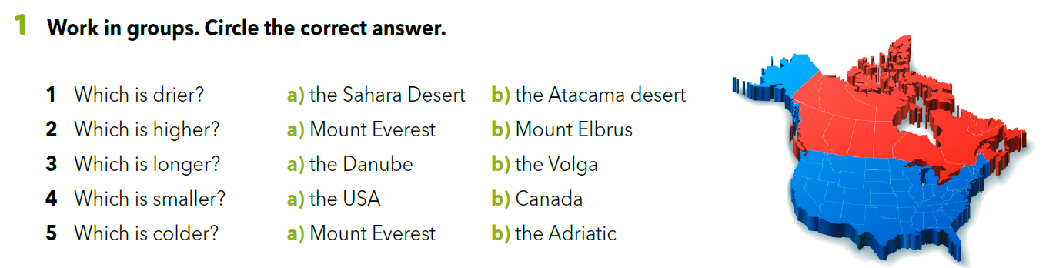
Which country are the places in?
Which continent are the places on?

Slide 4
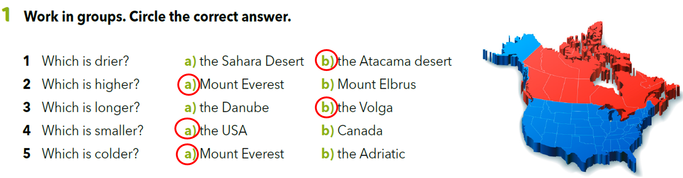
Underline all the adjectives in task 1.
What do all these adjectives have in common?
The suffix -er.
This form of adjectives is called the comparative.

Slide 5
How do we form the comparative of short adjectives?
adjective + -er
high →
cold →
long →
small →
dry →
easy →
high + -er = higher visok → viši
cold + -er = colder hladan → hladniji
longer dugačak → duži
smaller malen → manji
dr + i + -er =drier suh → suši
easier lagan → lakši
If the adjective ends in –y, we change -y in –i and then add the suffix –er.

Slide 6
Copy the comparative in your notebook.
Then write the adjective next to them.
high
cold
long
small
dry
easy
→ higher
colder
longer
→ smaller
→ drier
→ easier

Slide 7
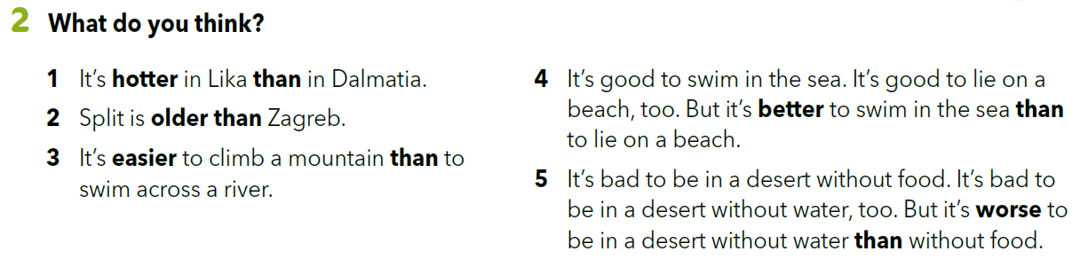
Are the statements true (T) or false (F)?
Sometimes we double the final consonant and then add the suffix –er.
hot → hot + t + er = hotter
Discuss your answers with other pupils. Check your answers online.

Slide 8
Some adjectives have irregular comparative.
better dobar → bolji
worse loš → lošiji
good →
bad →
We use the comparative to compare one person, thing or place to another.
The Volga is longer than the Danube.
The USA is smaller than Canada.

Slide 9
Copy the comparatives from task 2 in your notebook.
Then write the adjective next to them.
hot
old
good
bad
hotter
older
better
worse

Slide 10
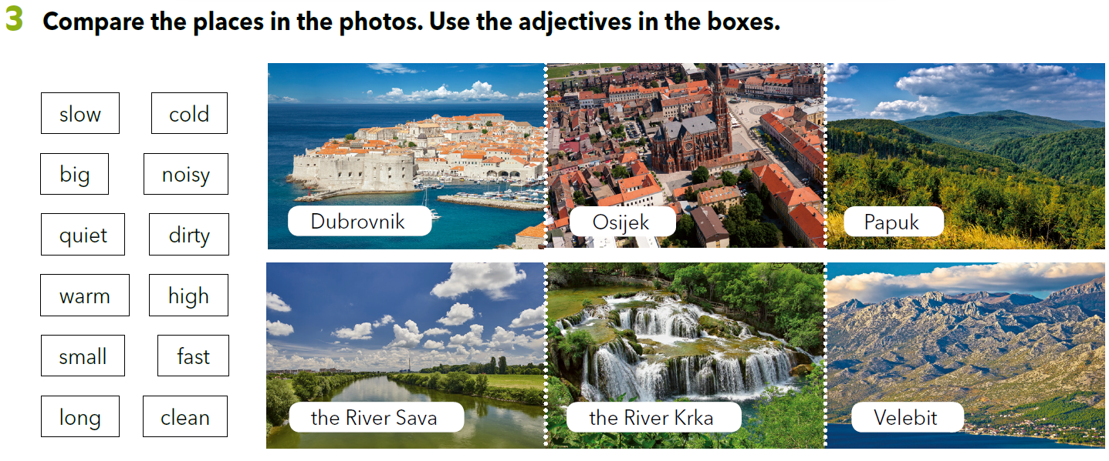
Write 6 sentences in which you compare the places in the photos.

Slide 11

LET’S REVISE!
PLAY AND LEARN
https://learningapps.org/watch?v=pc0p3p4e218
SELF CHECK.
https://www.e-sfera.hr/dodatni-digitalni-sadrzaji/247ca72f-c515-466e-a849-a868d8b1981a/

Slide 12
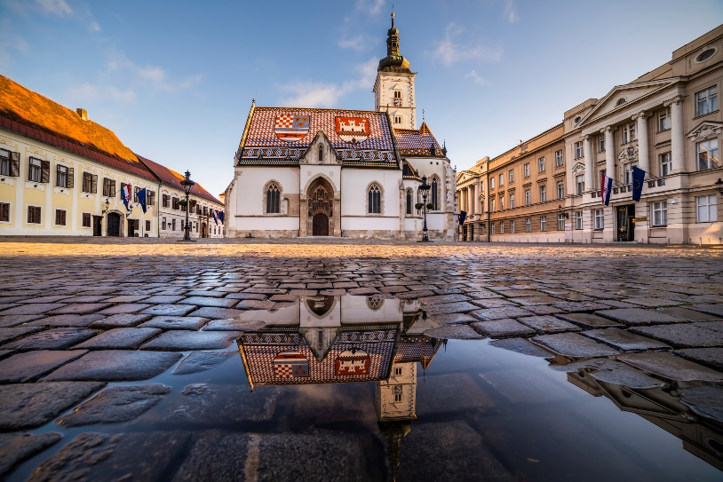
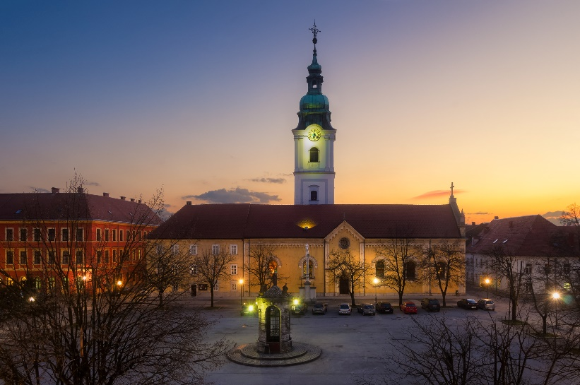
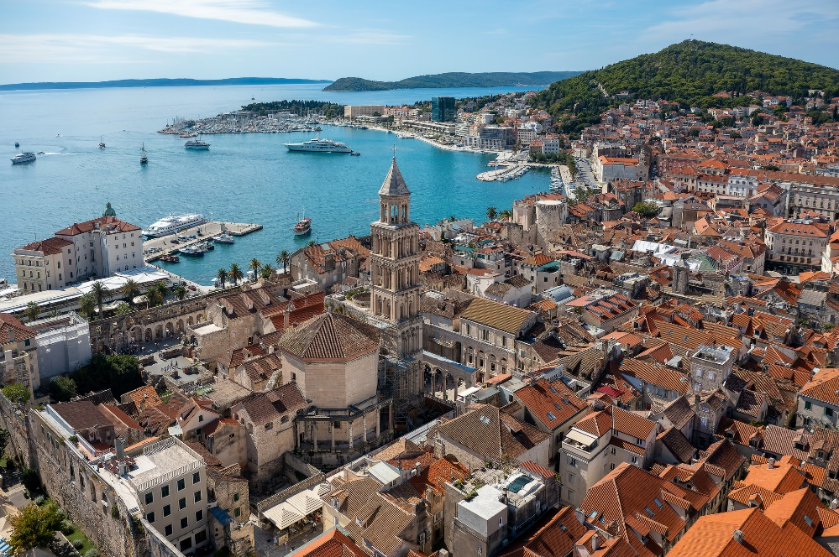
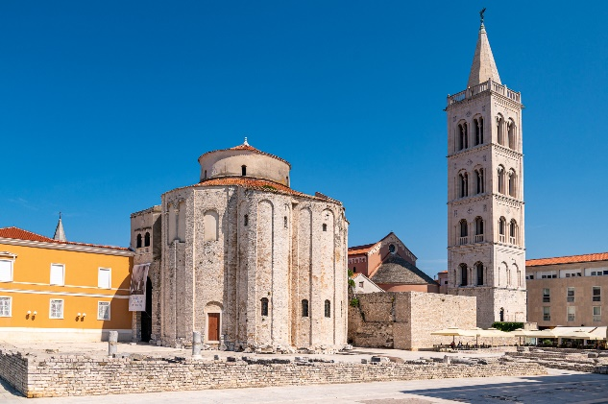
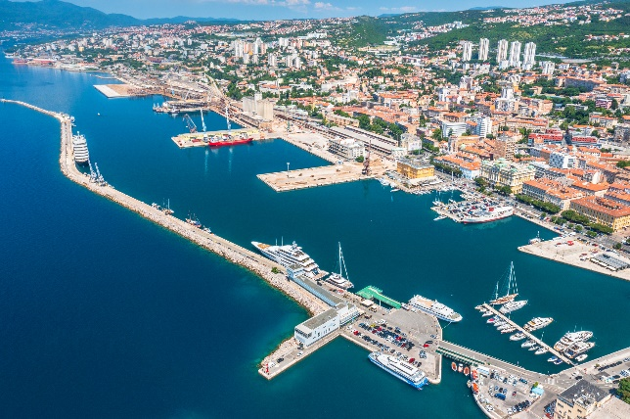

Slide 13
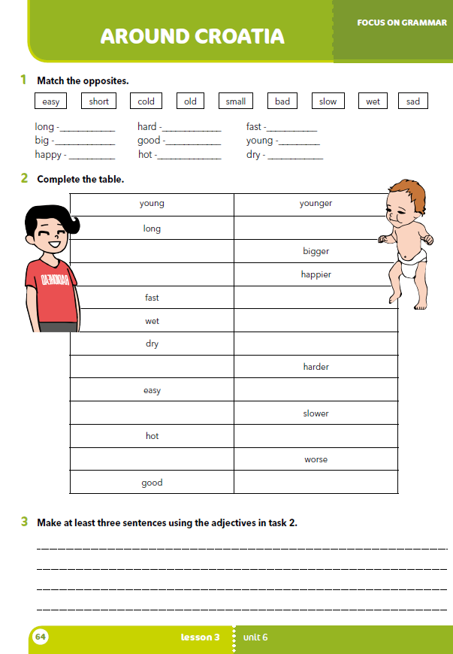
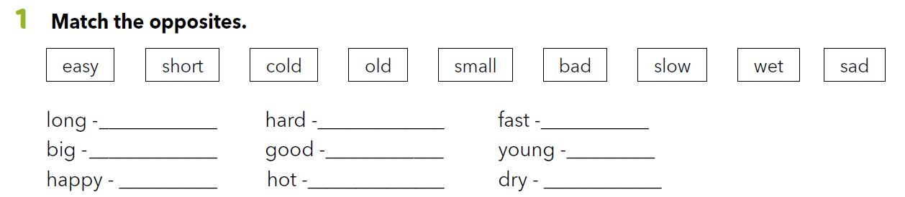
Workbook p. 64
short
easy
slow
small
bad
old
sad
cold
wet

Slide 14
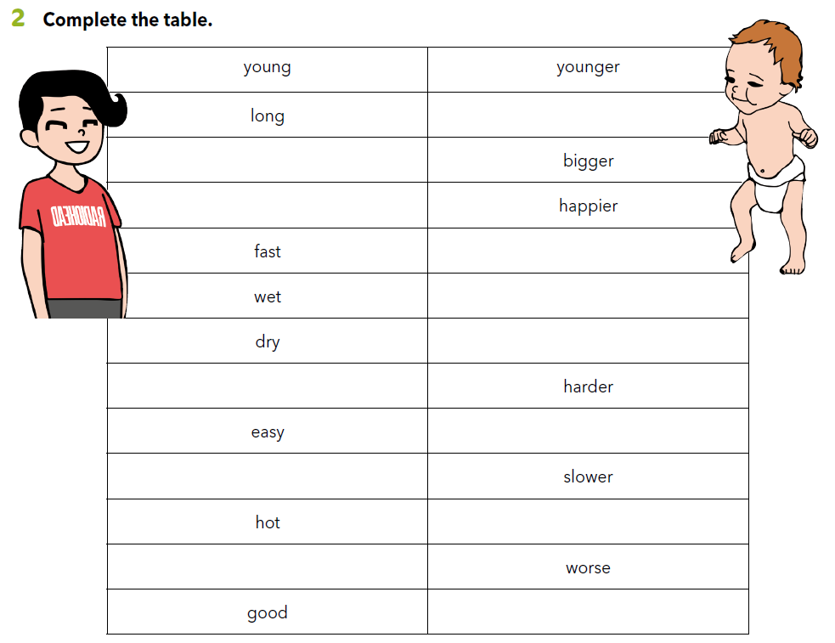
longer
big
happy
faster
wetter
drier
hard
easier
slow
hotter
bad
better

Slide 15
